Slide 1
Image Sharpening Filter- The Gradient Operator
Upadhyay Shreyans Indresh
Image and Vision Processing
MSc IT Part 1
Roll No. 18

Slide 2
Index
Introduction
Blurring vs Sharpening
Derivative Operator

Slide 3
Introduction
The principle objective of sharpening is to highlight fine details in an image or to enhance details that has been blured.
High spatial frequency components have detailed information in the form of edges and boundaries.
Image Sharpening algorithms are used to separate object outlines.
Therefore , image sharpening filters are known as edge enhancement or edge crispening algorithm.

Slide 4
Blurring vs Sharpening
Blurring/smoothening is done in spatial domain by pixel averaging in a neighbors, it is a process of Integration.
Sharpening is an inverse process, to find the difference by the neighborhood, done by spatial differentiation. This difference can be evaluated with the help of differentiation.

Slide 5
Derivative Operator
This operator calculates the gradient of the image intensity at each point, given direction of the largest possible increase from light to dark an drate of change in that direction.
Image differentiation
Enhances edges and other discontinuities (noise).
Deemphasizes area with slowly varying gray-level values.

Slide 6
Derivatives
The derivative of digital function are defined in terms of differences.
There are various ways to define these differences.
First Order Derivative
Must be zero in the area of constant intensity
Must be non-zero at the onset of the intensity step or ramp
Must be non-zero along ramps
Second Order Derivative
Must be zero in constant areas
Must be non-zero at the onset and end of the intensity step or ramp: and
Must be zero along ramps of constant slope

Slide 7


Sharpening Spatial Filter
The Basic definition of first order derivative of 1-D function is give by
Second order derivative is defined as
Explanation
d2f/dx2=(f(x+1)-f(x))-(f(x)-f(x-1))
d2f/dx2=(f(x+1)-f(x)-f(x)+f(x-1))
d2f/dx2=(f(x+1)-2f(x)+f(x-1))

Slide 8
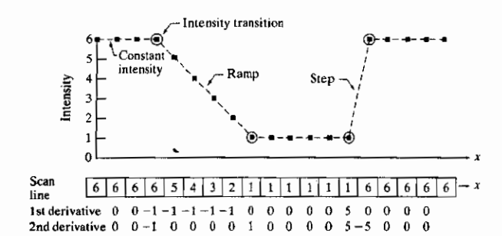
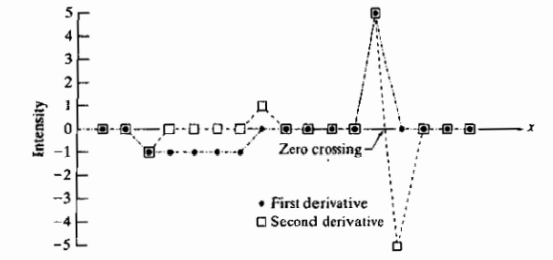
Illustration of first and second derivatives of a 1-D function
As the figure shows, the scan line contains an intensity ramp, three sections of constant intensity, and an intensity step.
The circle indicate the onset or end of intensity transaction

Slide 9

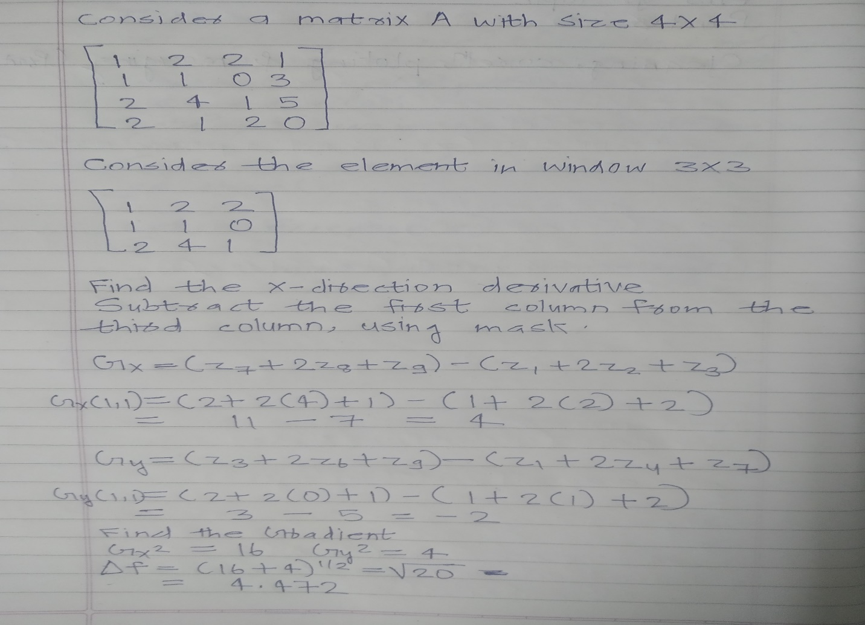
Sobel Edge Detection method
In sobel edge detection, the gradient of the image is calculated for each pixel position of the image.
Where Gx is for x direction and Gy is for y direction

Slide 10
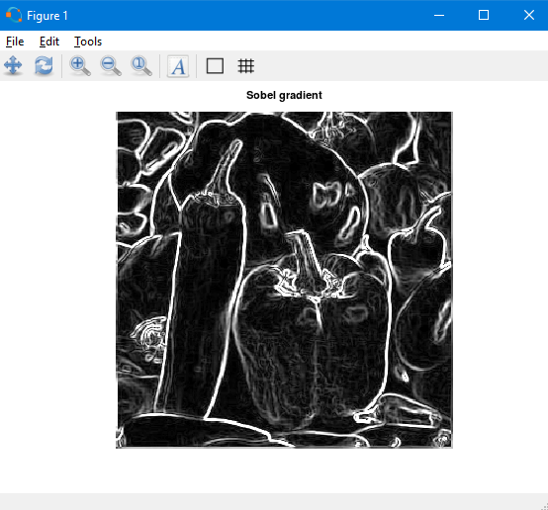
Sobel Edge Detection method
Matlab Code
A=imread('peppers.jpg'); #read the image
B=rgb2gray(A); #convert to rgb
C=double(B);
for i=1:size(C,1)-2
for j=1:size(C,2)-2
%Sobel mask for x-direction:
Gx=((2*C(i+2,j+1)+C(i+2,j)+C(i+2,j+2))-(2*C(i,j+1)+C(i,j)+C(i,j+2)));
%Sobel mask for y-direction:
Gy=((2*C(i+1,j+2)+C(i,j+2)+C(i+2,j+2))-(2*C(i+1,j)+C(i,j)+C(i+2,j)));
%The gradient of the image
%B(i,j)=abs(Gx)+abs(Gy);
B(i,j)=sqrt(Gx.^2+Gy.^2);
end
end
figure,
imshow(B);
title('Sobel gradient');

